Slide 1
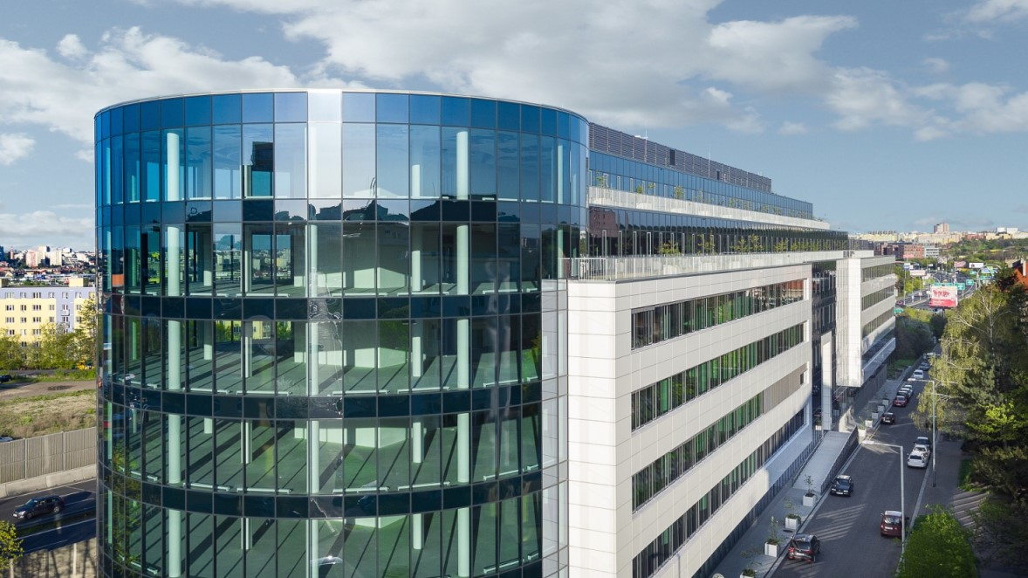
Czech Real Estate Funds
TRF Ranking 2020 – Q2

Slide 2
Executive Summary [1/2]
Czech Real Estate Mutual Market Development
Institute of Strategic Investments of Faculty of Finance and Accounting University of Economics and Hospodarske noviny issued TOP real estate funds ranking („TRF”) for Q2 2020. The ranking is being issued every quarter since 2017.
The results of Q2 2020 present 13 funds of qualified investors and 7 retail funds. During the time we broaden not only the number of funds in ranking but also the quantity of information about each fund. If the fund wants to participate in TRF it has to fulfill the requirement of publicly traded securities.
The sector of real estate funds grows very quickly. The balance of these funds soared to CZK 41.3 bn which about 15 % more than in previous year.
Overall balance of real estate funds is 11 % of all investment funds whereas in 2010 it was only 0,8 %. After the simple deposit to a bank account is a deposit to the investment funds second highest and between 2013 and 2018 the value of these deposits doubled.
The ranking is divided into two categories – funds of qualified investors (FQI) and retail funds. The overall value of real estate portfolio of funds in our ranking is CZK 96 bn. During the last 3 months rose the value of this portfolio by more than 5 %. In this period we estimate the overall investments of funds about CZK 100 bn.
The most frequent minimal investment required by FQI is CZK 1 mil, in case of retail fund it is CZK 500. The entrance fee is usually around 3% and the exit fee is in most cases after three years 0. Current number of investors to the funds participating in TRF is around 175 000. From these funds 87 % of them has domicile in Czech republic and 13 % abroad.
41.3 bn CZK
total funds in the Czech real estate mutual funds in TRF ranking
96 bn. CZK
Total value of properties owned by funds included in TRF ranking
6.5% vs 0.8%
Czech real estate funds represented 6.5% of investment funds in 2019 compare to 0.8% in 2010
27 %
y-o-y increase in total funds
175 000+
investors in TRF ranked real estate funds
87 %
Funds in TRF have domicile in the Czech Republic
61.5%
LTV not exceeding
1) Čerpáno z AKAT
[1/2]

Slide 3
Executive Summary [2/2]
Czech Real Estate Funds Market Development
Between FQIs in last 12 months the highest yield performed Accolade Industrial Fund, Czech Capital RE Fund SICAV, and Generali realitni fond. Between retail funds the highest yield performed Trigea nemovitostní fond SICAV, a.s., Investika Realitní Fond, and Conseq Realitní. In the category yield of last 3 years the best results among FQIs achieved Arete Invest CEE II, Accolade Industrial Fund, and WOOD & Company Office podfond and between retail funds ZFP Realitní fond, Investika Realitní Fond, and Conseq Realitní.
The market of real estate funds in Czech republic is the fastest growing market between investment funds but it is also going to be influenced by the crises resulting from coronavirus.
Generally we can say that the average WAULT of real estate funds in Czech republic is around 5.6 years and accordingly to our data LTV of none of the funds exceeds 61.5 %.
We assume that funds participating in TRF have a good chance to survive the crisis without any bigger troubles. But it will also depend on the time frame of government restrictions, since the exposure of the Czech funds to the retail sector is quite large.
Outcome of current economic situation will depend a lot on how he funds communicate to their investors to stay calm and not panic because of short-time fluctuations. The investment to the real estate is intended for a long-term and a thanks to its timescale it is resistant to crises.
TOP 3 Funds of Qualified Investors
according to their profitabllity in last 12 months
1. | Accolade Industrial Fund | 12.8%
2. | Czech Capital RE Fund SICAV | 9.0%
3. | Generali realitní fond | 8.3%
TOP 3 Retail Funds
according to their profitabllity in last 12 months
1. | Trigea nemovitostní fond SICAV, a.s. | 6.8%
2. | Investika Realitní Fond | 5.3%
3. | Conseq Realitní | 5.2%
[2/2]

Slide 4
Content
Real Estate Funds of Qualified Investors
Retail Real Estate Funds
1
2
In all graphs are the funds sorted according to their Yield in last 12 months as of 30th June 2020

Slide 5
1. Real Estate Funds of Qualified Investors
Yield in last 12 months as of 30th June 2020

Slide 6
1. Real Estate Funds of Qualified Investors
Average annual yield in last 3 years as of 30th June 2020

Slide 7
1. Real Estate Funds of Qualified Investors
Average annual yield from the beginning of operation of the fund

Slide 8
1. Real Estate Funds of Qualified Investors
Number of Investors

Slide 9
1. Real Estate Funds of Qualified Investors
Loan to value (LTV)

Slide 10
1. Real Estate Funds of Qualified Investors
Overall value of real estate property (millions of CZK)

Slide 11
1. Real Estate Funds of Qualified Investors
Overall investments in Q2 2020 (millions of CZK)

Slide 12
1. Real Estate Funds of Qualified Investors
Overall investments as of 30th June 2020 (millions of CZK)

Slide 13
1. Real Estate Funds of Qualified Investors
Quantity of sqm for rent

Slide 14
1. Real Estate Funds of Qualified Investors
Quantity of sqm for rent in the largest estate

Slide 15
1. Real Estate Funds of Qualified Investors
Share of the estate generating most of revenue on total revenue

Slide 16
1. Real Estate Funds of Qualified Investors
Weighted average unexpired lease term (WAULT)

Slide 17
1. Real Estate Funds of Qualified Investors
Number of tenants

Slide 18
Content
Real Estate Funds of Qualified Investors
Retail Real Estate Funds
1
2
In all graphs are the funds sorted according to their Yield in last 12 months as of 30th June 2020

Slide 19
2. Retail Real Estate Funds
Yield in last 12 months as of 30th June 2020

Slide 20
2. Retail Real Estate Funds
Average annual yield in last 3 years as of 30.6.2020

Slide 21
2. Retail Real Estate Funds
Average annual yield from the beginning of operation of the fund

Slide 22
2. Retail Real Estate Funds
Number of Investors

Slide 23
2. Retail Real Estate Funds
Loan to value (LTV)

Slide 24
2. Retail Real Estate Funds
Overall value of real estate property (millions of CZK)

Slide 25
2. Retail Real Estate Funds
Overall investments in Q2 2020 (millions of CZK)

Slide 26
2. Retail Real Estate Funds
Overall investments as of 30th June 2020 (millions of CZK)

Slide 27
2. Retail Real Estate Funds
Quantity of sqm for rent

Slide 28
2. Retail Real Estate Funds
Quantity of sqm for rent in the largest estate

Slide 29
2. Retail Real Estate Funds
Share of the estate generating most of revenue on total revenue

Slide 30
2. Retail Real Estate Funds
Weighted average unexpired lease term (WAULT)

Slide 31
2. Retail Real Estate Funds
Number of tenants

Slide 32
Authors
Institut of Strategic Investments (Faculty of Finance and Accounting, University of Economics, Prague)
Disclaimer
This presentation contains information obtained from third parties and calculations based on that data.
Any information is provided solely for informative purposes and thus must not be relied on by the readers. We thus bear no liability or guarantee of accuracy, potential misinterpretation, further use or abuse of any information, data, estimations and statements included in our presentation.
These information is not intended for any further publication or distribution without the consent of the authors.
Please be also advised that this presentation comprises predictions, estimations and personal opinions addressing present, past or future market situation („Statement“). Such Statements do not depict any historical facts and can include opinions and presumptions based on personal opinions of authors or third-party sources that were deduced from aggregated data and estimations from them. Although we believe that the Statements included in our presentation are based on logical presumptions, these statements are also a subject of estimates, subjective opinions and uncertainties. No risks, estimations, opinions and uncertainties linked to information in this presentation were investigated in an exhausting manner. As a result, you should not consider these statements to be a certain prediction of future events and situation, nor should you expect the presumed goals to be achieved. For avoidance of doubt, we therefore do not accept any responsibility in relation to any statements and information included in this presentation.
Matouš Ryška toprealitnifondy@isti.cz
Hospodářské noviny

